Slide 1
DOCKER COMPOSE

Slide 2
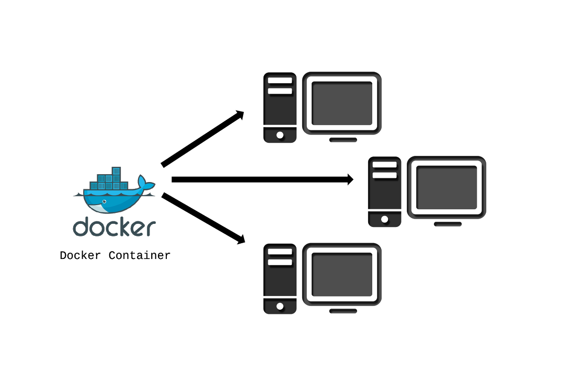
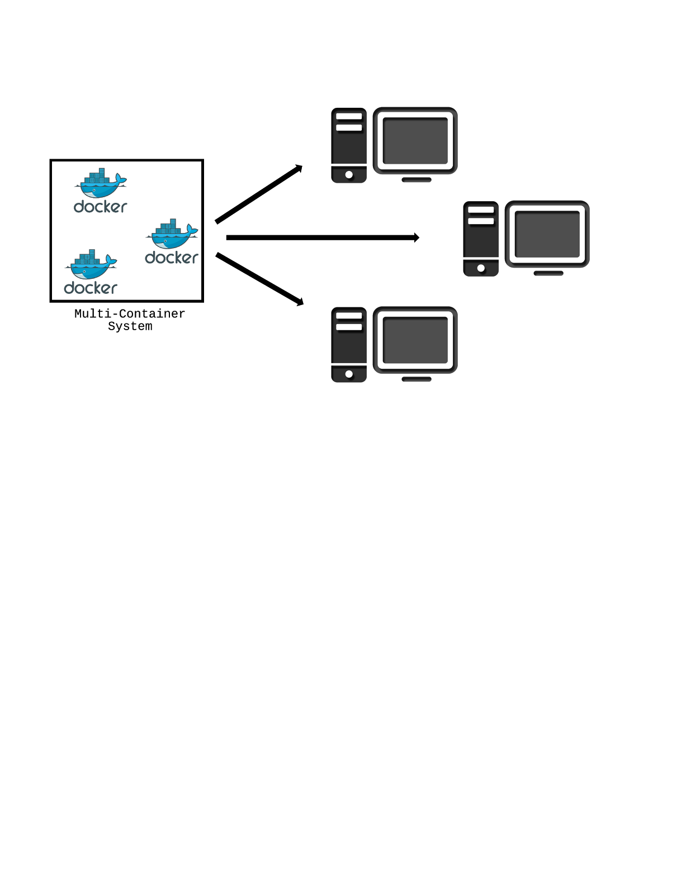
Requirement

Slide 3
What is Docker Compose?
Docker Compose is a tool for defining, running, and managing complex multi-container systems
Specify images and configuration in a simple YAML file: docker-compose.yml
One command to get it all running: $ docker-compose up

Slide 4
Docker Compose
docker-compose up: what happens inside
Builds images from Dockerfiles ( optional in compose file )
Pulls images from registries ( optional in compose file )
Creates and starts containers with the configuration
Streams their logs
With docker-compose Make your development environments:
Repeatable
Isolated
Fast

Slide 5
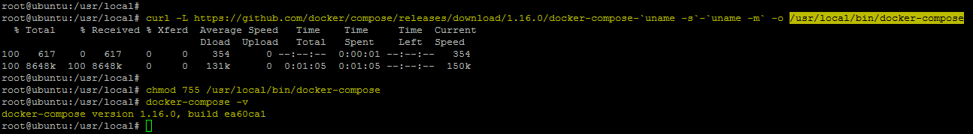
Install Docker Compose
On your Machine run below
curl -L https://github.com/docker/compose/releases/download/<version>/docker-compose-`uname -s`-`uname -m` -o /usr/local/bin/docker-compose
version = required version
look https://github.com/docker/compose/releases for available versions

Slide 6
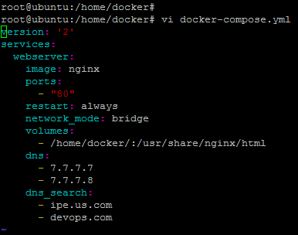
Deploy Apps Using docker-compose.yml
On your Machine create a directory /home/docker & create a file docker-compose.yml
mkdir –p /home/docker ; cd /home/docker
touch docker-compose.yml
vi docker-compose.yml & enter below then save the file

Slide 7

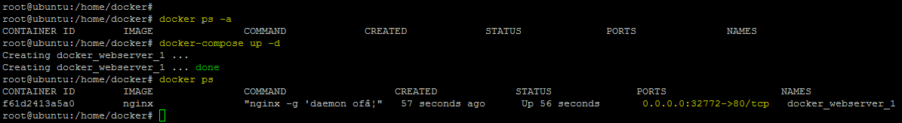
Under /home/docker folder create a html file called index.html & enter any text in it
Now Let’s Run our Nginx container Using Docker Compose

Slide 8
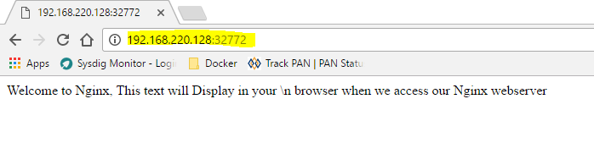
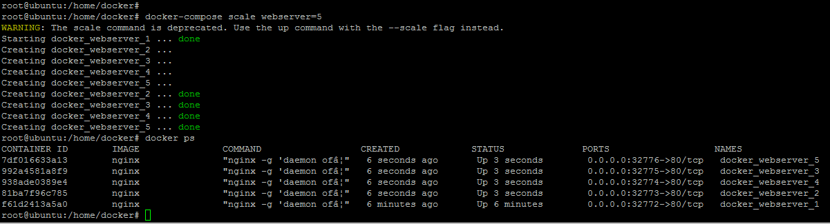
Let’s Access our WebServer using the Port & check if it works.
Can We Spin more Containers ? Yes We can

Slide 9
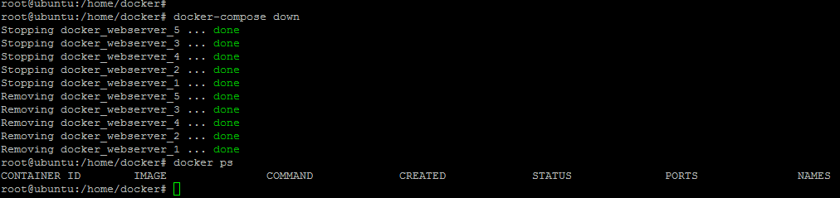
Docker Compose Down

Slide 10
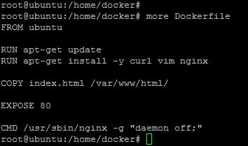
Build & Deploy Apps with docker-compose.yml
Step1 : Create a Dockerfile to build your custom Image
Step2 : Create a docker-compose.yml uses Dockerfile to build & Deploy
Dockerfile

Slide 11
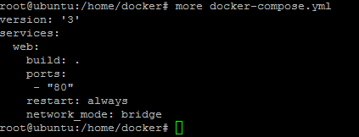
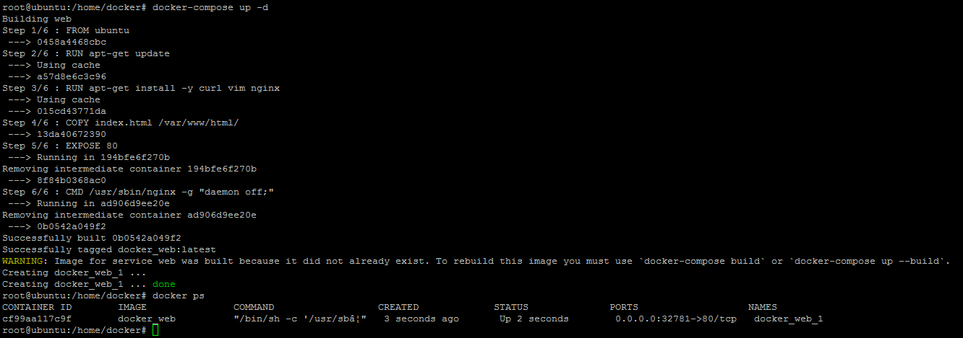
Build & Deploy Apps with docker-compose.yml
docker-compose.yml

Slide 12
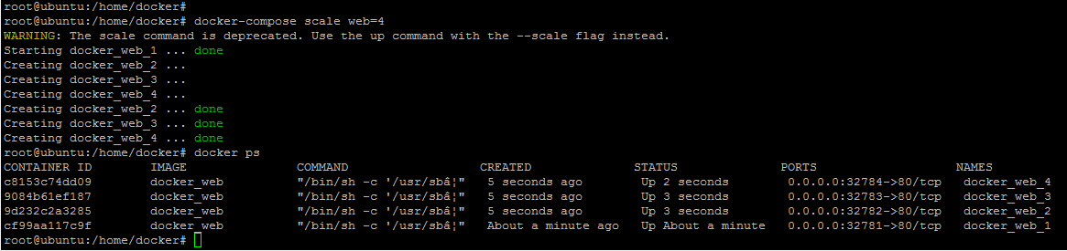
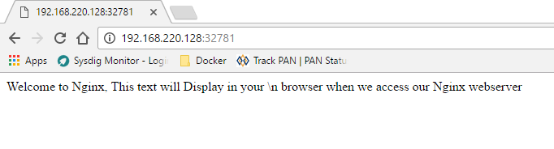
Build & Deploy Apps with docker-compose.yml

Slide 13
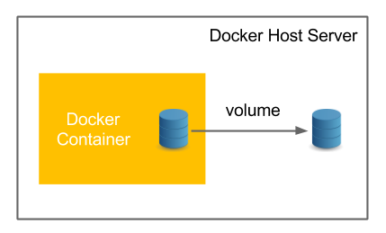
Docker Volumes
Volumes are the preferred mechanism for persisting data generated by and used by Docker containers

Slide 14
We can create the Volumes by using docker volume command
docker volume create my-vol
A volume named my-vol will be created under /var/lib/docker/volumes
cd /var/lib/docker/volumes
root@ubuntu:/var/lib/docker/volumes # ll
total 32
-rw------- 1 root root 65536 Mar 26 06:48 metadata.db
drwxr-xr-x 1 root root 10 Mar 26 06:48 my-vol
We can map this volume to your container, so that
your container can write any data on to your host operating system
can pick any configuration file from your volume required for your app
How to Map ?

Slide 15
Lets have again example of nginx webserver for which we have default html page created
cd /var/lib/docker/volumes/my-vol/_data
touch index.html
vi index.html
<!DOCTYPE html>
<html>
<body>
<h1>My Custom WebPage</h1>
<p>I like creating my own webpages</p>
</body>
</html>
Lets run our nginx webserver by mapping this volume
docker run -d -P -v my-vol:/usr/share/nginx/html nginx

Slide 16
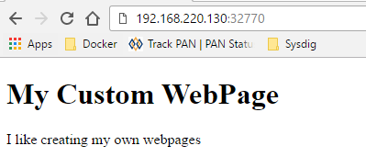
Check the nginx webserver is running by running docker ps command
root@ubuntu:~ # docker ps
CONTAINER ID IMAGE COMMAND CREATED STATUS PORTS NAMES
57dba686140e nginx "nginx -g 'daemon ..." 10 minutes ago Up 9 minutes 0.0.0.0:32770->80/tcp practical_keller
Let’s check if nginx is able to pick our custom html page we created

Slide 17
We can actually do same by simply running below command instead of creating volume by docker volume create command
docker run –d –P –v /tmp/test/:/usr/share/nginx/html nginx
In above command
/tmp/test is source path on your host os
/usr/share/nginx/html is path where nginx default html page exist
If /tmp/test directory does not exist on your host os it will create it
docker volume create command always creates the volume under /var/lib/docker/volumes/<vol-name> directory
For custom source directory paths we can follow the above simply.

Slide 18


